Slide 1
1. Technology Stacks
Microservices architecture built on top of the Spring Boot Framework
Frontend: We can either choose one of the followings: (Preferably React)
AngularJS with templates, components, services and HTTP client making rest call to the backend
React with UI components, Redux, Flux, Routing, Immutable.js, and Relay that makes REST calls to the backend

Slide 2
1. Technology Stack
Backend:
Spring Boot Microservices on Red Hat Openshift Container Platform
Spring Stack
Spring MVC is built on the Servlet API and uses a synchronous blocking I/O architecture with a one-request-per-thread model (not consider using Spring WebFlux non blocking web framework built from the ground up to take advantage of multi-core, next generation processors and handle massive numbers of concurrent connections)
Servlet Containers
Servlet API
Spring Security (LDAP auth Server/OAuth2)
Spring MVC
Spring Data Repositories: JDBC, JPA
Red Hat Openshift Stack (integration of client library and service in cloud deployment with Spring in three major components : Service Registry, Load Balancer and Circuit Breaker)
Tomcat server support well Spring Boot framework
Kubernetes service (internal load balancer)
Service Registry
Eureka (REST) in AWS cloud for locating services/load balancing and failover
Consul (discovering and configuring services)
Zookeeper (for configuration, naming and synchronization)
OpenShift cluster resolves the IP address for load balancer
Hystrix for Circuit breaker that stop cascading failure and provide resilience
Zuul for proxy/ dynamic routing
External Configuration
Spring Cloud Config
Openshift configMaps

Slide 3
1. Technology Stack
AWS:
Installing a OpenShift Cluster with Containers
We will add service to the Redhat Openshift service catalog that can provision/deprovision via AWS Service Broker, which in turn create/delete a collection of AWS service/PostgreSQL using cloudFormation.

Slide 4
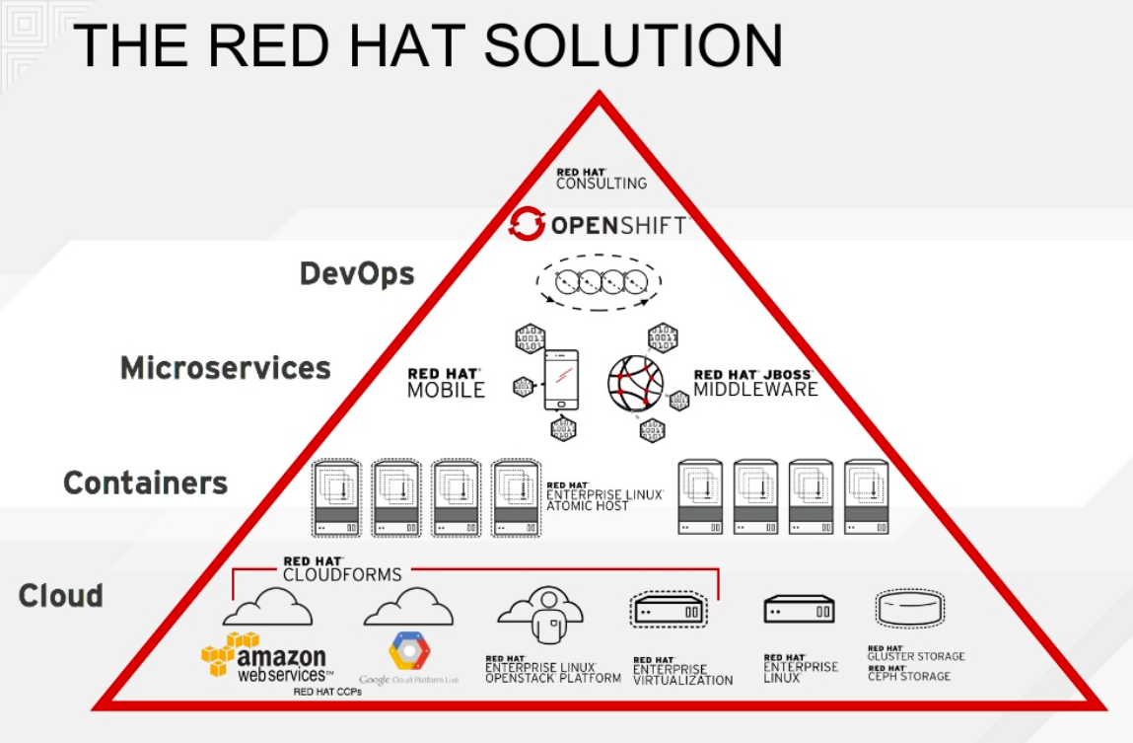
2. Container solution(OpenShift) vs Lambda vs Container + Lambda with Data Flow

Slide 5
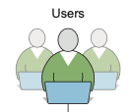


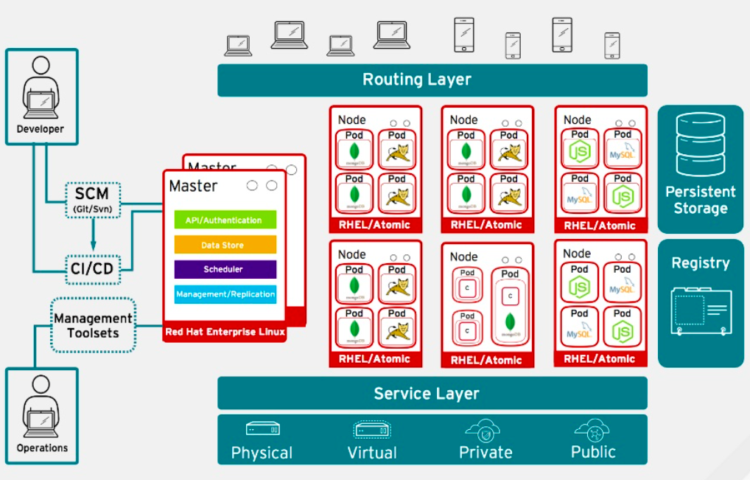





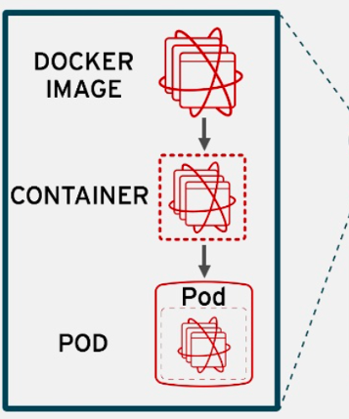
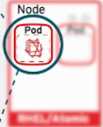



Routing Layer – provides easy DNS access and a consistent endpoint for all application in VPC
Register - provides container images to build and deploy application on the node
Service Layer – encapsulates the application’s business logic and coordinating responses
Eureka Server
Config Server
Single SignOn
ACL
Zuul
Bitbucket
PostgreSQL Database
Image
CONSUL

Slide 6
